Slide 1
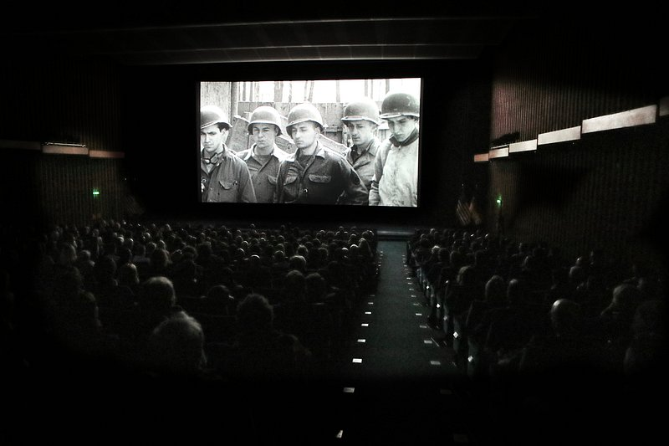
A JAVA MINI PROJECT
Cinema Seat
Booking System
Team Members
Rithvik
Roll No: 2620030592
Harsha Deep
Roll No: 2620030193
Sohan Samuel
Roll No: 2620030394

Slide 2
Abstract
The Cinema Seat Booking System is a Java-based application that lets users choose a movie, view the seat layout and book tickets. It calculates the fare based on the seat type, applies a group discount on bulk bookings and generates a bill for the customer. The system makes ticket booking fast, simple and error-free.
Fast
Simple
Error-free

Slide 3
Introduction
Background
Booking a cinema seat should be quick, clear and reliable for every viewer.
Our Solution
A Java application to select a movie, choose seats and get a bill instantly.
Benefits
Saves time for customers and calculates fares and discounts automatically.
Objective
To build a simple, user-friendly system that is easy to use and extend.

Slide 4
Existing vs Proposed System
Existing:ONLINE Booking
Proposed: Online Booking
Internet dependency
Heavy traffic, often crashes.
Often block seats.
Additional Website charges.
Very rare discounts.
Runs local , can run offline maintained by theatre owners.
Less traffic , doesn’t crash
No blocking of seats.
Comparatively less charges.
Discounts for heavy purchase of tickets

Slide 5
CO 1 Topics
Data types
int, char, String
double, Boolean
Operators
Arithmetic (+, -, *, /)
Relational (>, <=, ==)
Logical (&&, !)
Input
Scanner class

Slide 6
Co 2 TOPICS
Conditional statements
if
if-else
switch case (with default)
Control statements
for loop (nested)
for-each loop
break, continue, return

Slide 7
CO 3 Topics
Arrays
1-D array (String[] movies)
Methods
static void methods
Methods with parameters and return values
Method overloading

Slide 8
CO 4
Constructors
Default constructor
Parameterized constructor
Abstraction
abstract class with abstract methods
Encapsulation
private data members
public getters and setters

Slide 9
CO 5
String handling
String methods: nextLine(),toLowerCase(), toUpperCase().
File handling
Writing seat booking details into a file

Slide 10
Conclusion:
The system lets users choose a movie, view the seat layout and book tickets.
Fares are calculated by seat type, with a group discount on bulk bookings and an automatic bill.
It runs locally, avoids seat blocking and keeps booking fast, simple and error-free.
The project applies Java concepts from CO1 to CO5 and is easy to extend.

Slide 11
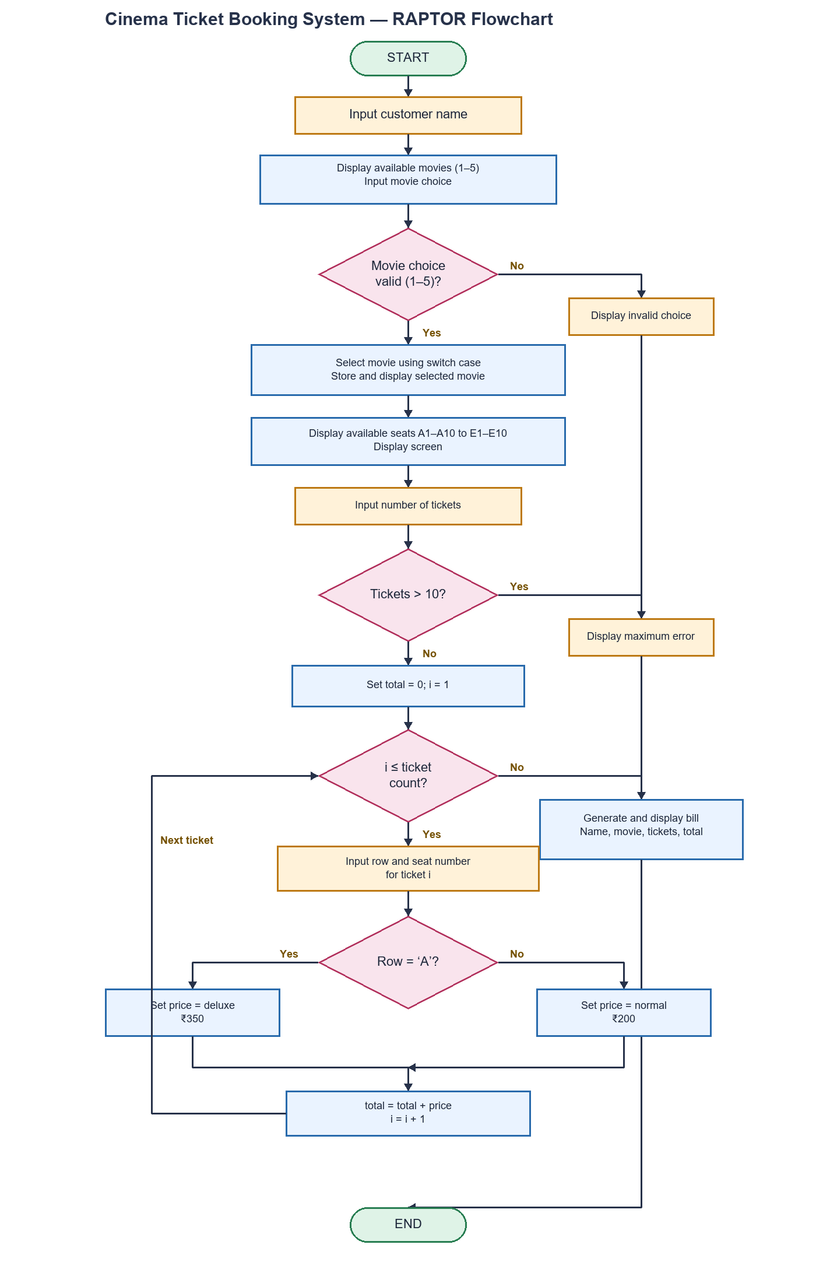
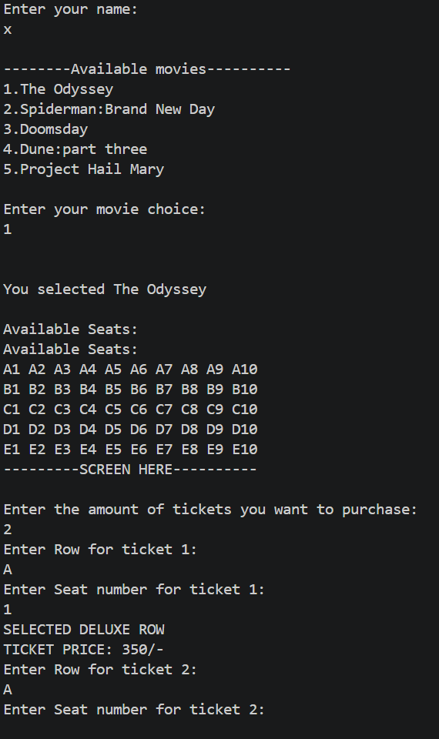
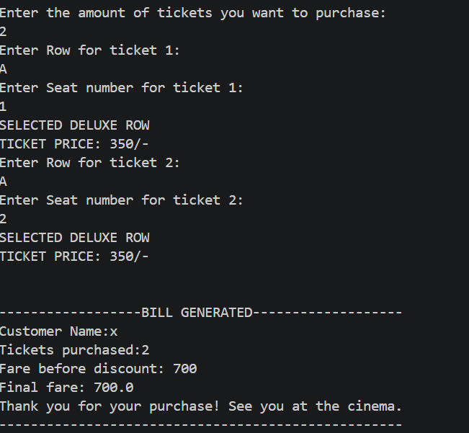
Screen Shots
Program flowchart
Program output
Program output (contd.)

Slide 12
Geo Tag Photo and git hub link
Paste geo-tagged photo here
GitHub link
https://github.com/Guthiharshadeep-lang/Batch-32-PSPJ-PROJECT

